Slide 1



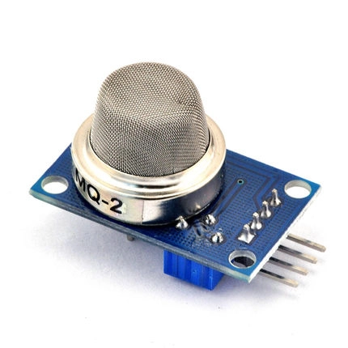
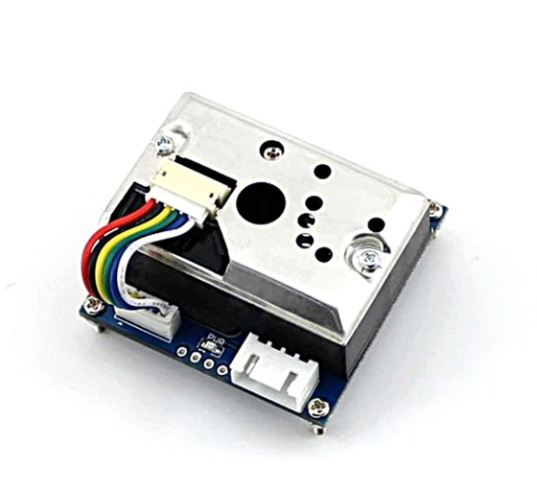
THE UNIVERSITY OF TECHNOLOGY - THE UNIVERSITY OF DANANG
FACULTY OF ELECTRONICS AND TELECOMMUNICATION
FINAL REPORT
MICROPROCESSOR ENGINEERING
CO AND PM2.5 CONCENTRATION MONITORING DEVICE
Group members:
Trần Quang Khánh - 22KTMT1
Lê Xuân Nam - 22KTTM1
Hồ Anh Nguyên - 22KTMT1
Phan Lê Minh - 22KTMT2
Supervisor: M. Sc. Hồ Viết Việt
Da Nang, December 26th, 2025

Slide 2
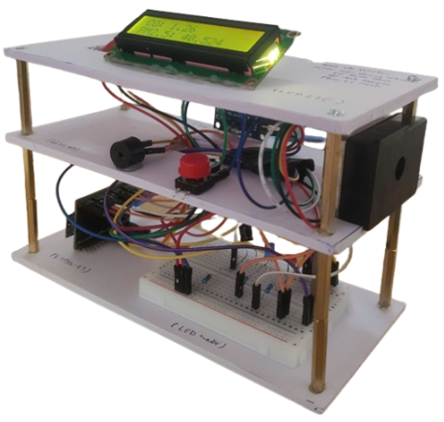
CONTENTS
Introduction
Schematic and Components
Implementation
Demo
Conclusion

Slide 3
CONTENTS
Introduction
Schematic and Components
Implementation
Demo
Conclusion

Slide 4
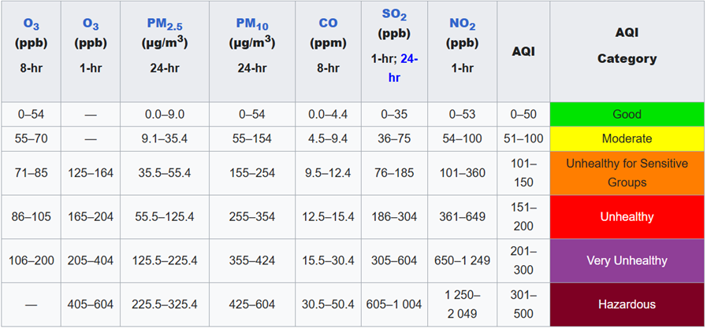
INTRODUCTION
CO and PM2.5 are hazardous air pollutants that pose serious health risks if not monitored in time.
Objective: Design a device to monitor and warn of CO and PM2.5 concentration levels.
System: Uses CO and PM2.5 sensors with an ESP32-C3 microcontroller for measurement and alerts.
Applications: Indoor air quality monitoring, fire detection, and smart safety systems.

Slide 5
CONTENTS
Introduction
Schematic and Components
Implementation
Demo
Conclusion

Slide 6
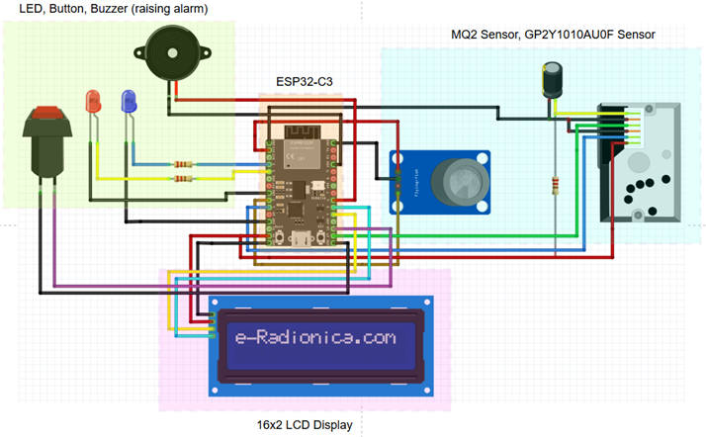
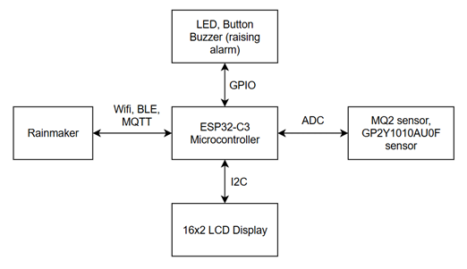
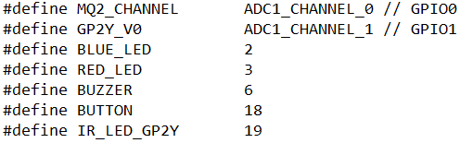
SCHEMATIC AND COMPONENTS
Hardware components used:
Main MCU: ESP32-C3 DevKit-M1.
Smoke Sensor: MQ-2.
PM2.5 Sensor: GP2Y1010AU0F.
Indicators: 2 LEDs, 1 buzzer, and 1 push button, 3 resistors.
Displays: 1 LCD 16x2 I2C.
Capacitor: 220uF/16V.

Slide 7
CONTENTS
Introduction
Schematic and Components
Implementation
Demo
Conclusion

Slide 8





IMPLEMENTATION
Software tools used:
ESP-IDF (C/C++ on VS Code)
ESP Rainmaker
Draw.io
Fritzing
Circuit diagram:

Slide 9
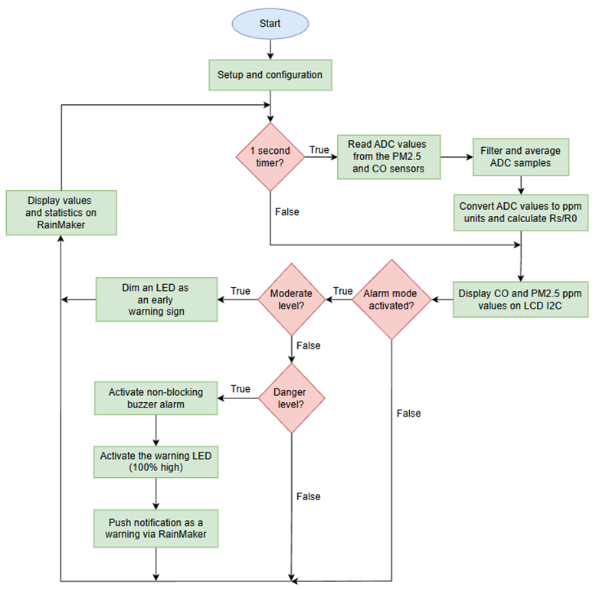
IMPLEMENTATION
Flowchart:
Implemented circuit:

Slide 10
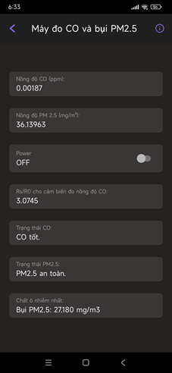
IMPLEMENTATION
ESP Rainmaker:
Implemented circuit:

Slide 11
CONTENTS
Introduction
Schematic and Components
Implementation
Demo
Conclusion

Slide 12
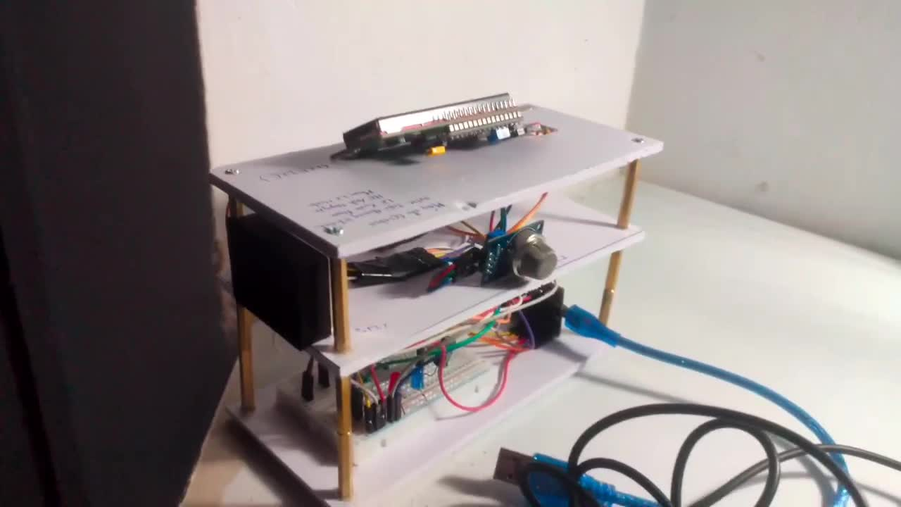

Slide 13
CONTENTS
Introduction
Schematic and Components
Implementation
Demo
Conclusion

Slide 14
CONCLUSION
Implemented a CO and PM2.5 monitoring device using MQ-2, GP2Y1010AU0F, and ESP32-C3.
The system monitors air quality, displays data, and triggers alarms at hazardous levels.
ESP RainMaker enables remote monitoring, alarm control, and hazard notifications.

Slide 15

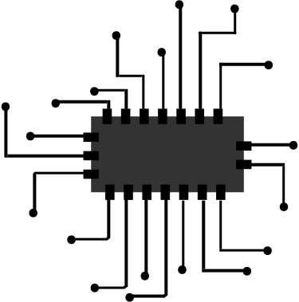

THANKS FOR LISTENING, AND HAPPY NEW YEAR!!

